Slide 1
Note 3
Data Modeling Using the Entity-Relationship (ER) Model
CSC134
Spring 2022
Dr. Haiquan Chen

Slide 2


ER diagram
We work as an data analyst in this chapter
A data model that allows data analyst to specify customer data requirements, based on which database designers can create a database

Slide 3
ER diagram
flowchart that illustrates how “entities” such as people, objects, relate to each other within a system.
We use symbols such as rectangles, diamonds, ovals and connecting lines to depict the data relationships.
Used to design or debug a database
Design a brand-new database
reveal where an existing database is going wrong.

Slide 4
Example COMPANY Database
Suppose we need to model the following requirements of the COMPANY database using ER:
The company is organized into DEPARTMENTs. Each department has a name, number and an employee who manages the department. We keep track of the start date of the department manager. A department may have several locations.
Each department controls a number of PROJECTs. Each project has a unique name, unique number and is located at a single location.

Slide 5
Example COMPANY Database
The database will store each EMPLOYEE personal info, e.g., social security number, address, salary, sex, and birthdate.
Each employee works for one department but may work on several projects.
The DB will keep track of the number of hours per week that an employee currently works on each project.
The DB will keep track of the supervisor of each employee.
Each employee may have a number of DEPENDENTs.
For each dependent, the DB keeps a record of name, sex, birthdate, and relationship to the employee.

Slide 6
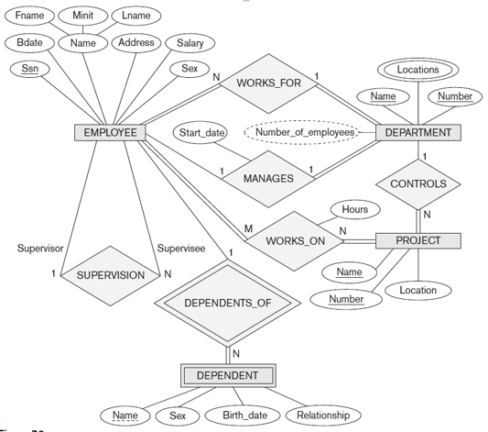
The final ER diagram

Slide 7
ER diagram
Next, you will learn how to design the ER diagram shown above step by step

Slide 8
ER model/diagram
ER model includes three components:
Entities
Relationships
Attributes

Slide 9
Entities and Attributes
Entity
An thing/instance in real world
Think of an entity as an “object” in OO programming
Attributes
Properties of an entity
Think of attributes as data fields for an “object”
Types of attributes:
Composite versus simple (atomic) attributes
Single-valued versus multi-valued attributes
Stored (base) versus derived attributes

Slide 10
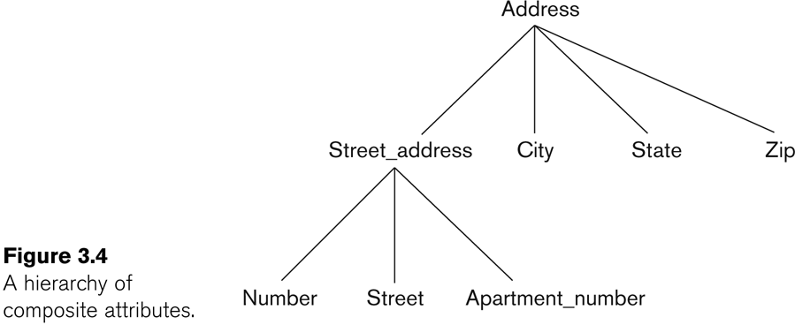
Composite versus simple (atomic) attributes
If an attribute is divisible into smaller subparts, then this attribute is composite. Otherwise, it is atomic.

Slide 11
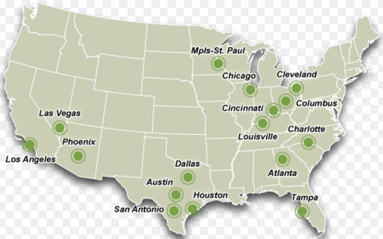
Single-valued versus multi-valued attributes
A COMPANY may have multiple locations
The attribute Locations: multi-valued.
The attribute Name: single-valued

Slide 12
Stored versus derived attributes
Age can be determined or implied by Birth_date so Age is a derived attribute.
On the other hand, we call Birth_date a stored (base) attribute

Slide 13
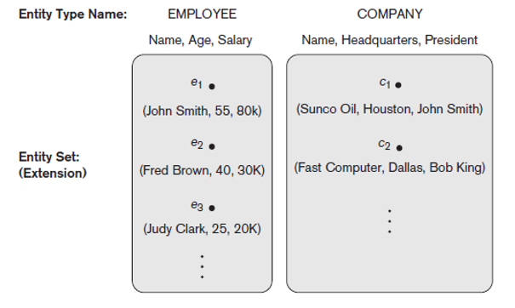
Entity Types
Entity type
All the entities in the same type
Think of a “class” in Java

Slide 14
Entity Types
An entity type is modeled as a box in ER diagram.
Attribute names are in ovals and are attached to their “owner” entity type by straight lines.
Composite attributes are attached to their each component by straight lines.
Multi-valued attributes are displayed in double ovals

Slide 15
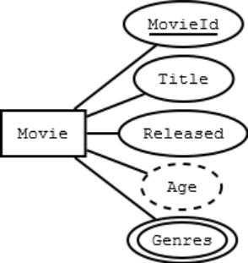
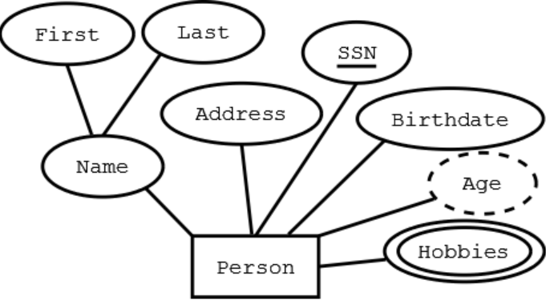
Examples

Slide 16
Entity Types
Key attributes
one attribute whose value is distinct for each entity
One entity type may have more than one key attribute.
We underline each key attribute in ER diagram

Slide 17
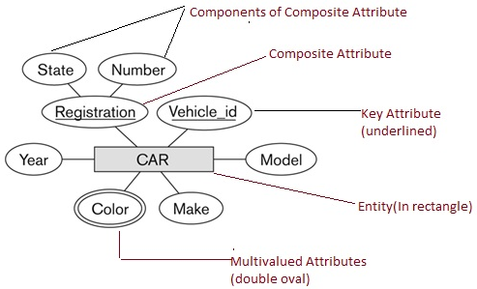
Example

Slide 18
Weak Entity Type
One entity type may have no key attribute, called as a weak entity type.
A week entity type is dependent on another entity type (owner entity type)
Double boxes: weak entity types
Double diamonds: the relationship between a weak entity type and its owner
A weak entity type has a partial key, which is the attribute that can uniquely identify a weak entity, given a owner entity.
Dashed-line: partial key

Slide 19
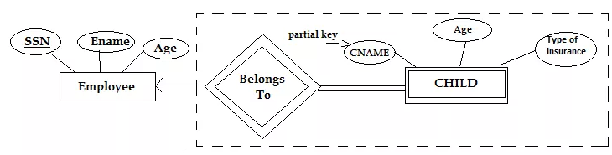
Example (Company DB)

Slide 20
So far we focused on entities.
Now, let’s move on to relationships

Slide 21
Relationship Types
A relationship type models a relationship among entity types
For example: “works_for” , “works_on” relationship types
Note that “works_for”, “works_on” are binary relationship types.
Relationship can also have attributes
For example, “hours” is an attribute of “works_on” relationship

Slide 22
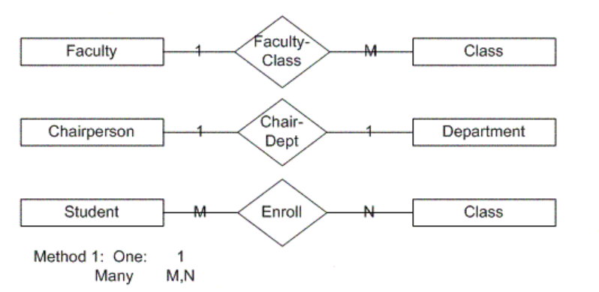
Relationship Types
In ER diagrams, we use diamond to represent the relationship types, which are connected to the involved entity types using straight lines

Slide 23
Two Constraints on Relationship Types
Cardinality Ratio (CR)
Specifies maximum number of entities involved in a relationship
Model the “at most” relationship
Types: 1:1; 1:N and M:N, where either N or M means MANY
Participation Constraint (PC)
Specifies minimum number of entities involved in a relationship
Models the “at least” relationship
Types: total (at least 1) and partial (at least 0)
Total： double-lines
Partial: single-line

Slide 24
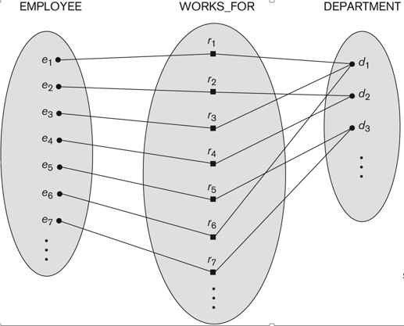
One-to-many (1:N) Relationship

Slide 25
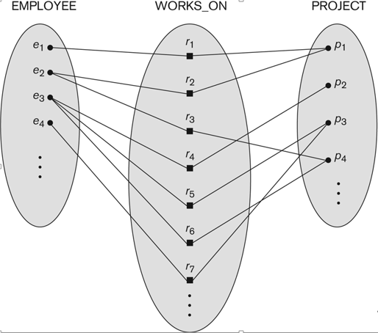
Many-to-many (M:N) Relationship

Slide 26
Requirements Revisit for COMPANY DB
We need to model the following requirements of the COMPANY database using ER:
The company is organized into DEPARTMENTs. Each department has a name, number and an employee who manages the department. We keep track of the start date of the department manager. A department may have several locations.
Each department controls a number of PROJECTs. Each project has a unique name, unique number and is located at a single location.

Slide 27
Requirements Revisit for COMPANY DB
The database will store each EMPLOYEE personal info, e.g., social security number, address, salary, sex, and birthdate.
Each employee works for one department but may work on several projects.
The DB will keep track of the number of hours per week that an employee currently works on each project.
The DB will keep track of the supervisor of each employee.
Each employee may have a number of DEPENDENTs.
For each dependent, the DB keeps a record of name, sex, birthdate, and relationship to the employee.

Slide 28
What relationships exist in such COMPANY database ?

Slide 29
Relationships identified
We may identify the following six relationships:
WORKS_FOR (between EMPLOYEE, DEPARTMENT)
MANAGES (also between EMPLOYEE, DEPARTMENT)
CONTROLS (between DEPARTMENT, PROJECT)
WORKS_ON (between EMPLOYEE, PROJECT)
SUPERVISION (between EMPLOYEE (as subordinate), EMPLOYEE (as supervisor))
DEPENDENTS_OF (between EMPLOYEE, DEPENDENT)

Slide 30
Put everything together

Slide 31
Note
A relationship type could defined between the same entity type
Example: the SUPERVISION relationship shown above
Each SUPERVISION relationship instance relates two distinct EMPLOYEE entities:
One employee in supervisor role
One employee in supervisee role

Slide 32
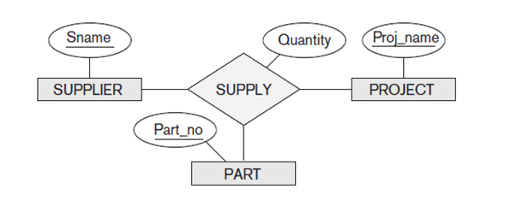
Relationships with degree more than 2
A relationship type may relate more than 2 entity types.
Can you work out the cardinality ratios for above ER?

Slide 33
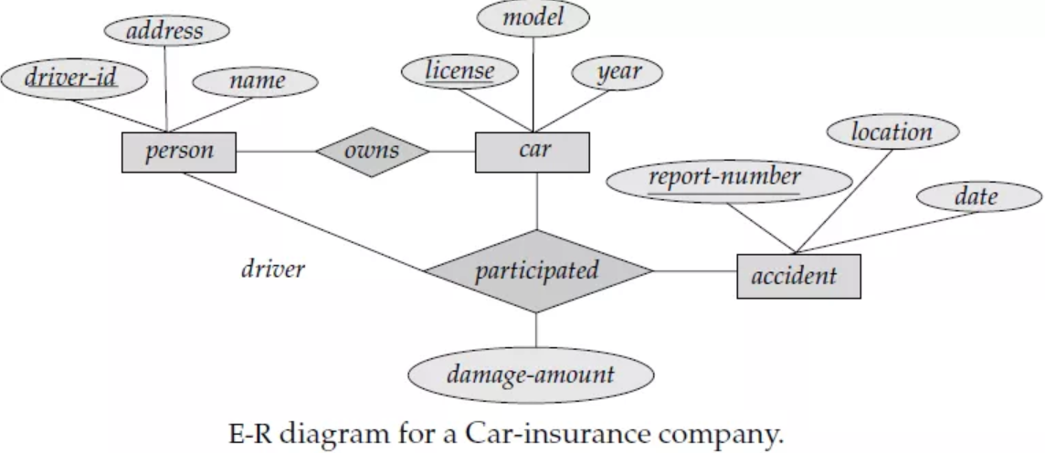
Can you work out the cardinality ratios for this ER diagram?

Slide 34
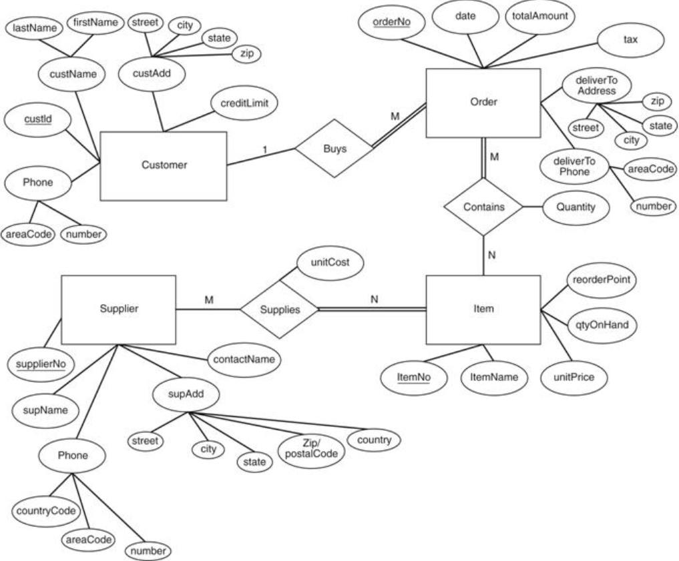
Another example ER diagram for an ordering system

Slide 35
Takeaway: How to design a ER diagram?
Understand your problem/data requirements
Identify entity types. Use nouns to name each entity type.
Identify attributes for each entity type.
Identify relationship types. Use verbs to name each relationship type
Identify attributes for each relationship type.
For each relationship type, specify (1) cardinality ratio and (2) participation constraint. You need such information to convert your ER diagram to relational schema!

Slide 36
Takeaway
An ER Diagram normally mirrors grammatical structure
Noun: Entity type. Example: student.
Verb: Relationship type. Example: Enrolls.
Adjective: Attribute for entity. Example: sophomore.
Adverb: Attribute for relationship. Example: remotely.

Slide 37
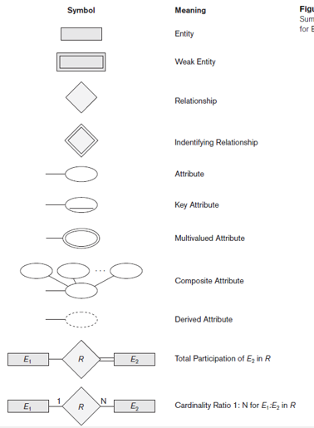
Takeaway: notations for ER diagrams

Slide 38
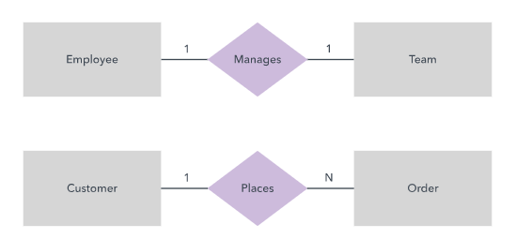
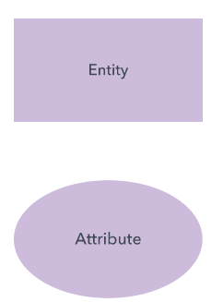
ER diagram styles
Chen (Peter Chen, developed ER in 1970s) notation style
(only use this Chen style in our class!!)
Most widely used in data science domain

Slide 39
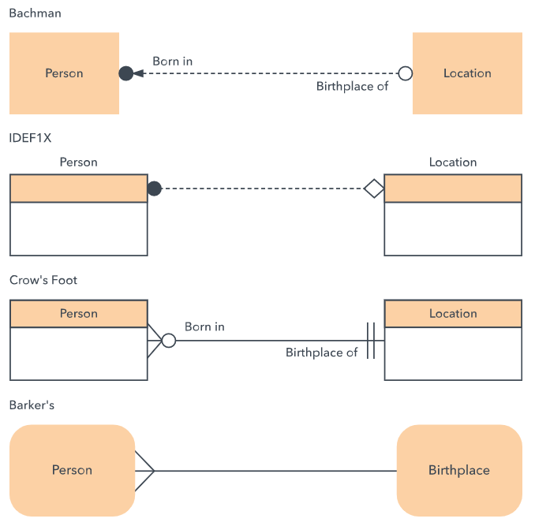
Don't use these styles

Slide 40
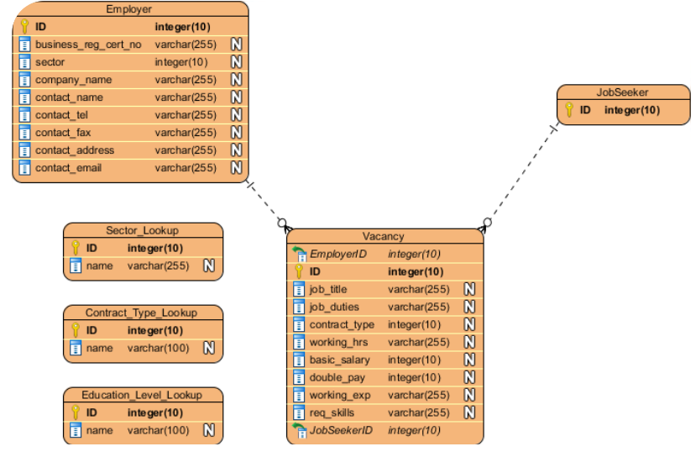
Don't use these styles

